Slide 1
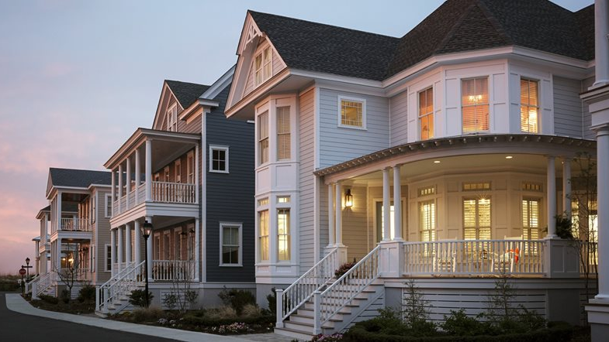





EXPERIENCE DIFFERENCE

Slide 2
AGENDA
ABOUT MHX DESIGNS
MHX DIFFERENCES
  PEOPLE
  MGT PROCESS
  TECHNOLOGY – HOW MHX CAN ASSIST YOUR SALES
HELPFUL INFORMATION ABOUT STUCCO

Slide 3
MHX’S MISSION AND CORE VALUE
SERVE
our clients and provide the best customer experience
and quality in the home remodeling industry.
MAKE A DIFFERNCE
for our employees, our business partners,
and our communities.

Slide 4
WHAT DO WE DO
AN EXTERIOR REMODELING CONTRACTOR
Specializes in stucco remediation
and a James Hardie Elite Installer

Slide 5
MORE THAN JUST A CONTRACTOR
A BUILDING SCIENCE EXPERT
A TRUSTED ADVISOR
A REMODELING DESIGNER
+400 EXTERIOR REMODELING PROJECTS IN LAST 5 YEARS
+200 STUCCO REMEDIATON PROJECT IN LAST 5 YEARS

Slide 6
OUR DIFFERENCES
TECHNOLOGY
MGT PROCESS
PEOPLE

Slide 7
PEOPLE
Q
CEO/PARTNER
SHANNON
OFFICE MGR
PROJECT MGT
SUNG
PROJECT MGR
TED
PROJECT MGR
CLAUDIO
SPECIALTY
MARK
COO/PARTNER
CLIENT MGT
PHIL
CLIENT MGR
MIKE
CLIENT MGR
IN-HOUSE TEAMS
MASONRY TEAM
SPECIALTY TEAM
DEDICATED 1099 SUBS
100% MHX
ALFREDO
ROOFING/STUCCO
TONY
HARDIE ELITE
ANGEL
HARDIE ELITE
VICTOR
HARDIE ELITE
OTHER PARTERS
GRADWELL
FRAMING
SANCHEZ
HARDSCAPING
MHX DESIGNS, LLC. HAS BEEN IN BUSINESS FOR 10 YEARS AS A CONTRACTOR.
  EXISTED AS A SUB-CONTRACTOR PRIOR TO MHX DESIGNS
WE HAVE 10 W2 EMPLOYEES - AVERAGE OVER 20 YEARS IN THE INDUSTRY.
4 FULL-TIME DEDICATED CREWS: +25 1099 CONTRACTORS
ALL THE CREW LEADERS WITH OVER 20 YEARS OF TRADE EXPERIENCE.
BEST IN CLASS EMPLOYEES AND PARTNERS

Slide 8

MANAGEMENT PROCESS
DELIVERING THE HIGHEST QUALITY OF PRODUCTS AND SERVICES
  CREATE A POSITIVE CULTURE AND ALWAYS ENGAGE PEOPLE WITH OUR MISSION STATEMENT IN MIND
  SERVE AND MAKE A DIFFERENCE
COTINUOUS TRAINING FOR OUR EMPLOYEES AND CREWS
  PRODUCTS AND PROCESS TRAINING
  BI-LINGUAL EMPLOYEES (SPANISH)
MHX CREW – A STRICT ON-BOARDING PROCESS
  PILOT PROJECTS – TEST AND LEARN
  FULLLY DEDICATED EMPLOYEMENT/SUB-CONTRACTOR MODEL
INNOVATION – NEW AND BETTER PRODUCTS
NEW SERVICES – ADD MORE VALUE-ADDED SERVICES

Slide 9
TECHNOLOGY
ACCURACY
SPEED
EFFICIENCY
INNOVATION
HELPING
PARTNER

Slide 10
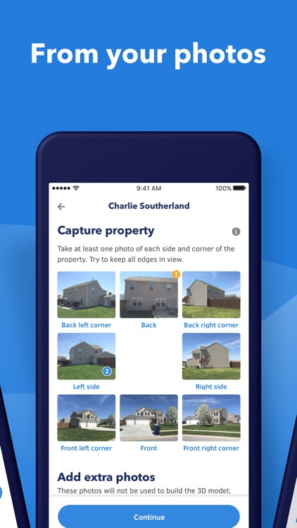


HOVER
Hover e360 3D System transforms smartphone photos of any home
to a comprehensive and accurate measurements on the property
and 3D rendering model to easily design and visualize the home.
UNDER ONE HOUR

Slide 11
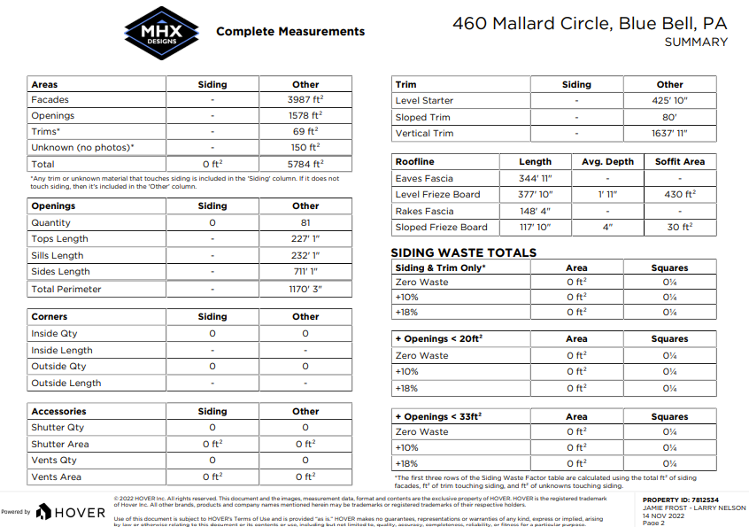
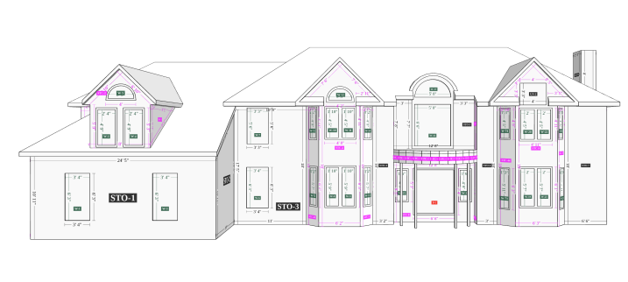
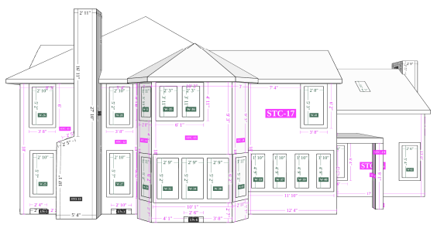
HOVER

Slide 12
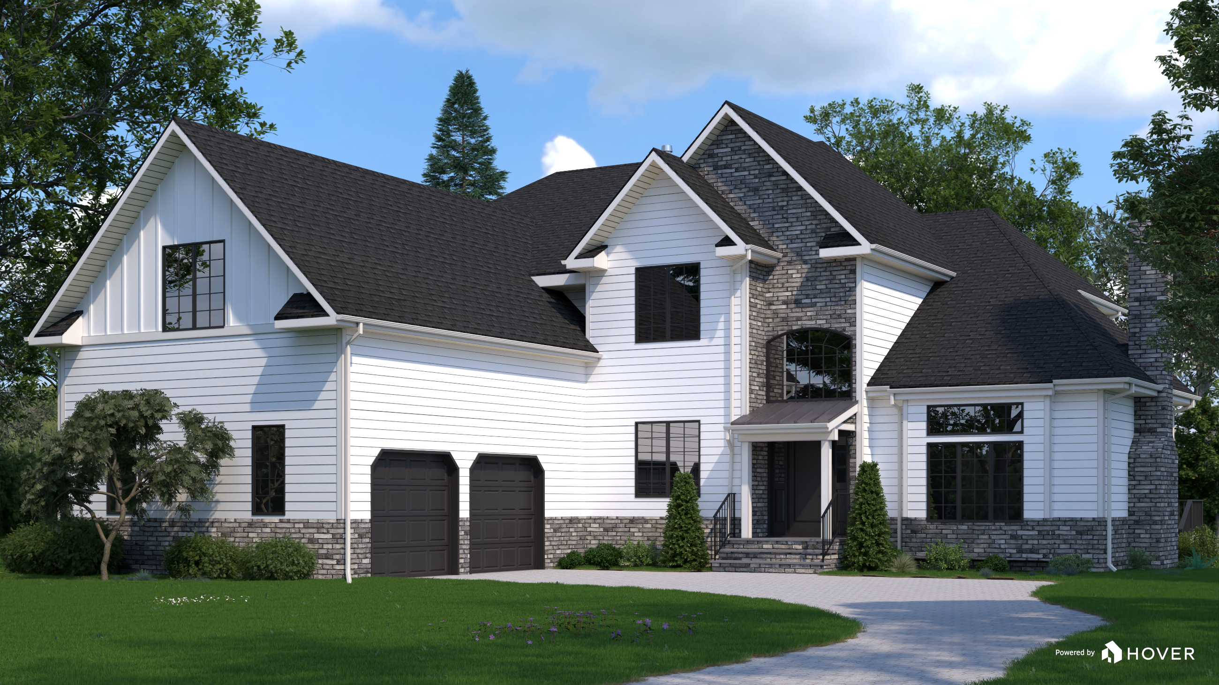
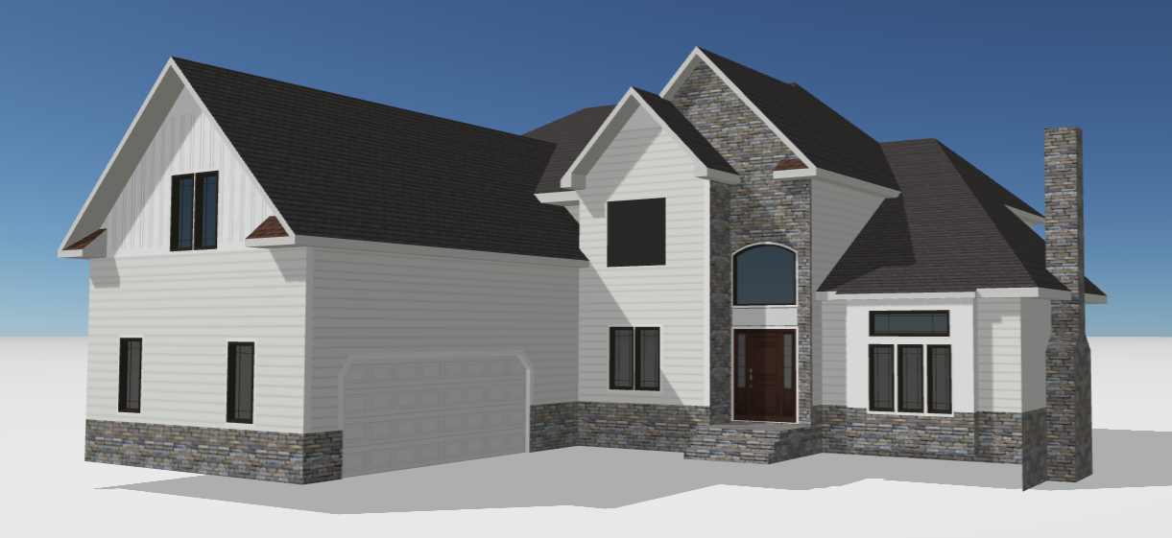
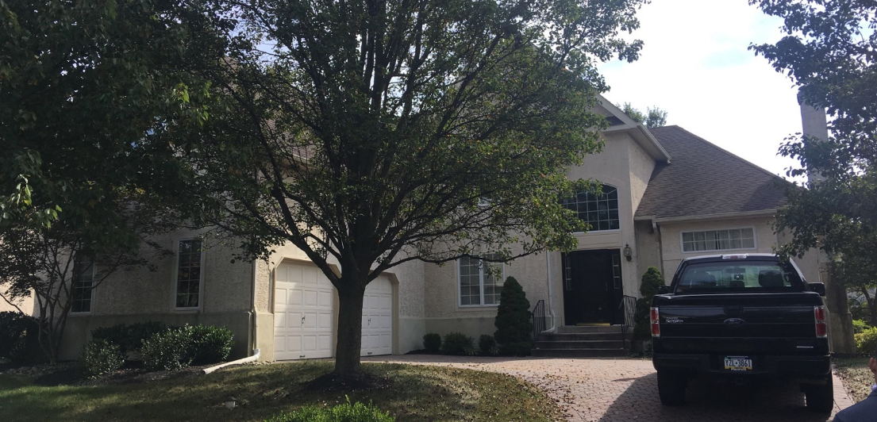
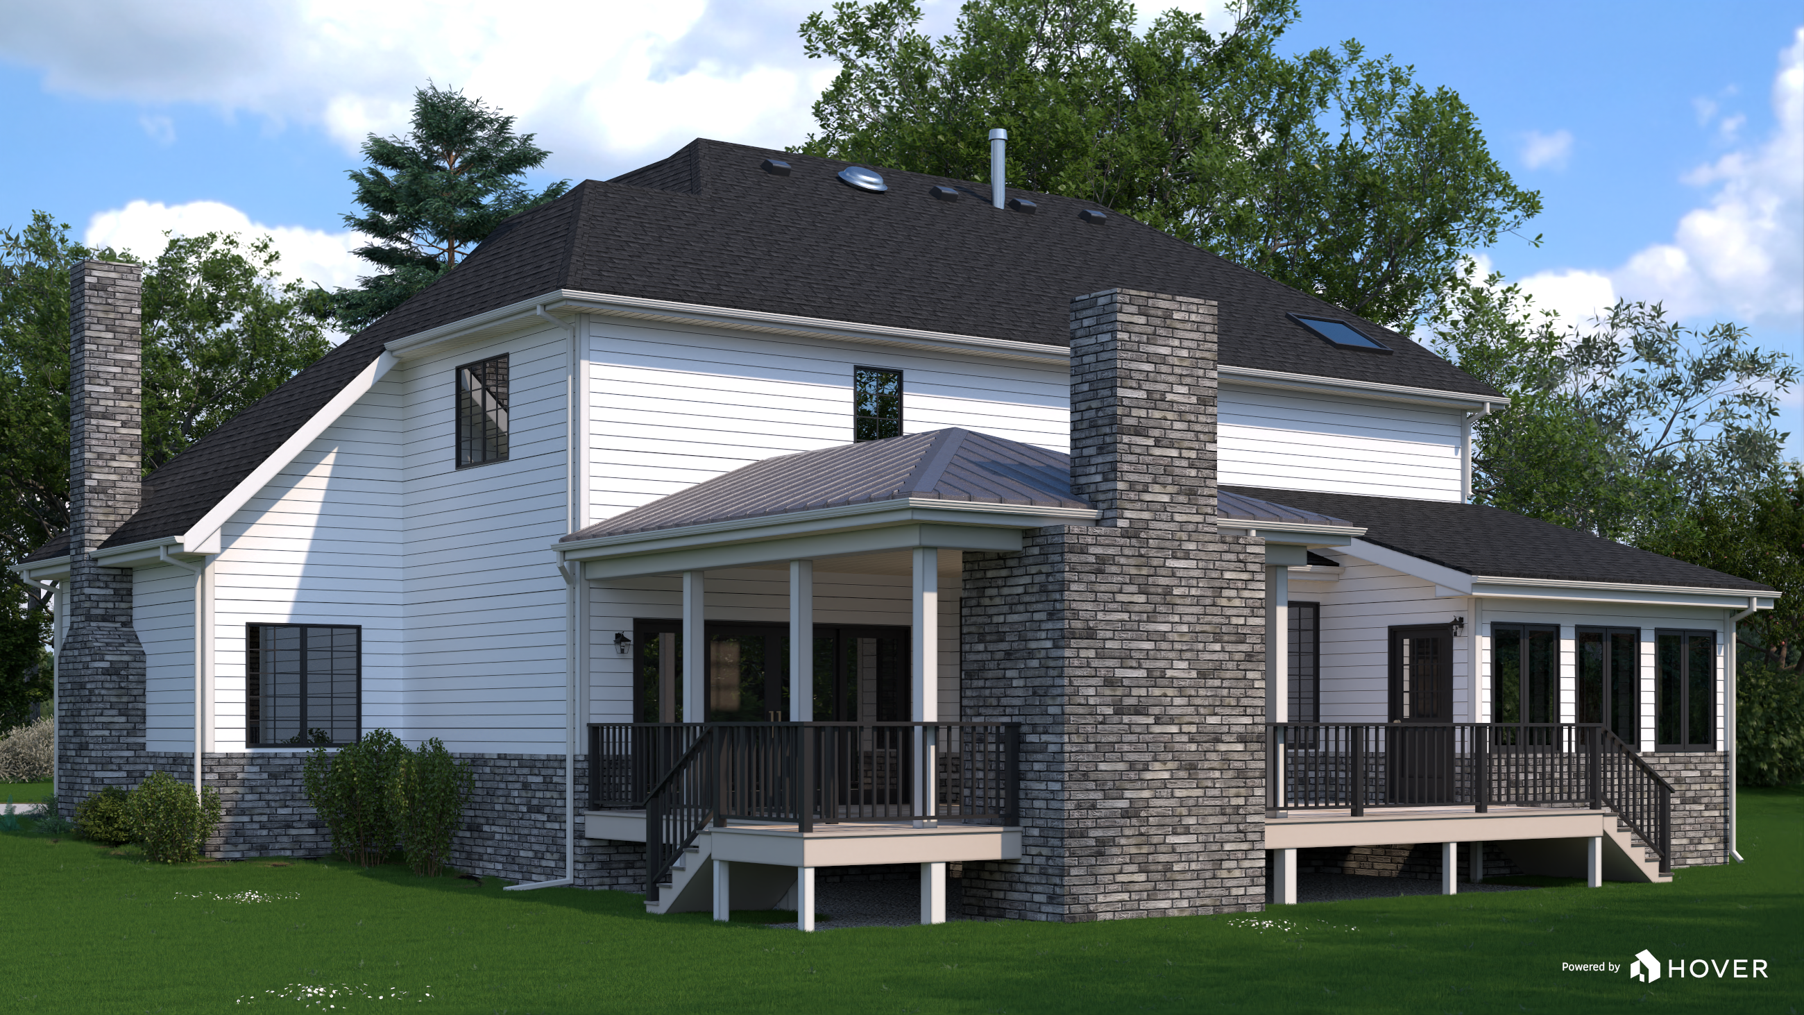
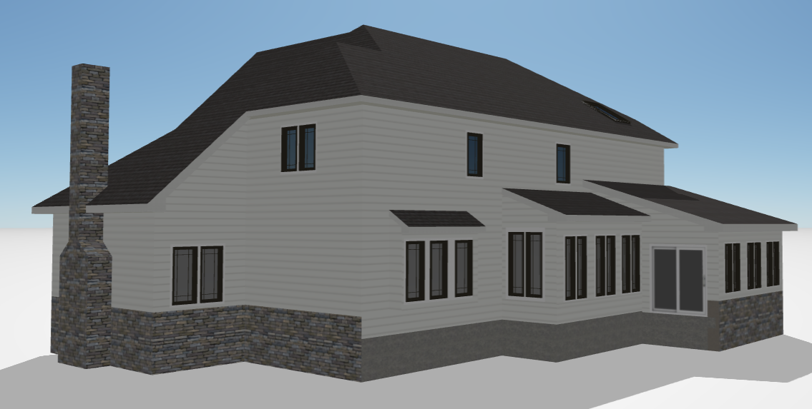
HOVER

Slide 13
MHX TECHNOLOGY DRIVEN PROCESS FOR YOU
AN AGENT CONTACTED ME SUNDAY NIGHT 11/13 WITH A STUCCO INSPECTION REPORT AND REQUEST OUR INSIGHT
CONTACTED THE AGENT AND DISCUSS ABOUT THE INSPECTION REPORT ON 11/14 8AM AND THEIR NEEDS
IMMEDIATE NEED: SELLER NEEDS AN ESTIMATE TO REPLACE THE STUCCO TO NEGOTIATE WITH THE POTENTIAL BUYER
THE FULL MEASUREMENT REPORT CAME BACK 12:42 PM.
PROVIDED MHX ASSESSMENT, RECOMMEDNATIO AND A PRELIMINARY ESTIMATE TO REPLACE THE STUCCO WITH VINYL BY 11/14 4:30 PM
I VISITED THE PROPERTY AROUND NOON, ASSESS THE HOME. AND HOVER THE PROPERTY

Slide 14
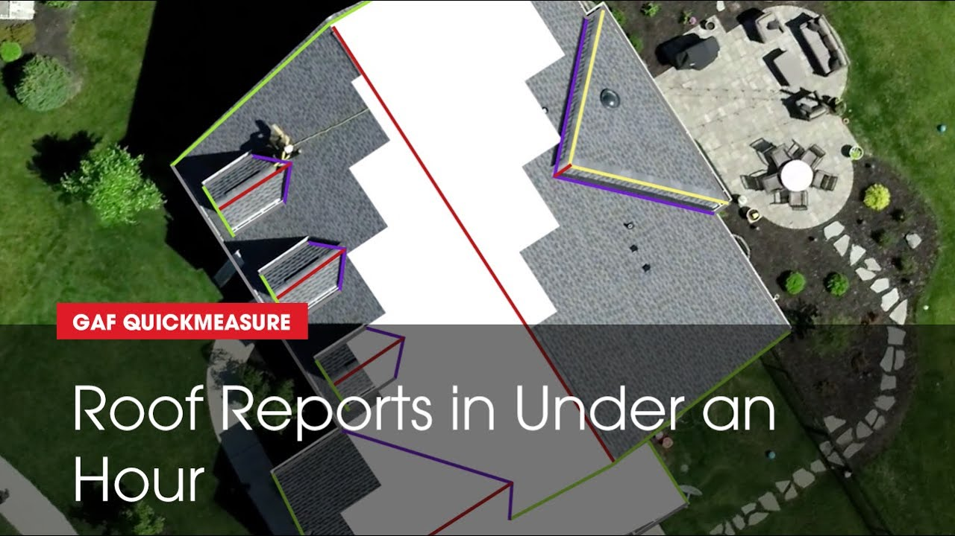
GAF QUICKMEASURE

Slide 15
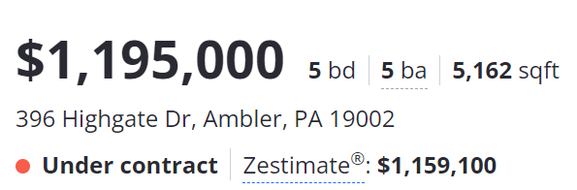
MHX TECHNOLOGY DRIVEN PROCESS FOR YOU
IMMEDIATE NEED: SELLER AND AGNET WANT TO REPLACE THE LEAKING ROOF AND SCHEDULE AN OPEN HOUSE ASAP
AN AGENT CONTACTED MHX 9/2/22 TO ASSESS THE ROOF AND PROVIDE AN ESTIMATE
ABLE TO SCHEDULE MHX ROOF CREW TO REPLACE THE ROOF ON 9/12/22 TO MEET THE OPEN HOUSE PLAN 10/1/22
IN ADDITION, MHX PROVIDED OTHER EXTERIOR SERVICES TO IMPROVE THE CURVE APPPEAL – NEW SHUTTERS, TRIM REPLACEMENT & PAINTING, SIDING REPAIRS, ETC.
RAN THE QUICKMEASURE REPORT AND PROVIDE A COMPETITVE BID ON THE SAME DAY

Slide 16
TECHNOLOGY DRIVEN PROCESS
REAL TIME MEASUREMENT
AUTOMATED PRICING
ONLINE CRM AND PROPOSAL SYSTEM
TURNAROUND
TIME 24-48 HRS

Slide 17
YOU ARE OUR VIP CLIENTS!
PROVIDE EXPERTISE
TURNAROUND SPEED
DELIVER QUALITY
MHX PROMISE

Slide 18
HELPFUL INFORMATION ABOUT STUCCO HOMES
Stucco is a porous exterior cladding and ABSORBS water and slow to dry.
The extreme Northeast weather is NOT ideal for stucco.
Stucco is ideal for a cinder block/concrete home – NOT wood framed home
Stucco standards have changed significantly in last 10 years.
Most stucco homes built prior to 2015 do not meet the current standards
Most new construction builders are NOT using stucco on their new homes
You cannot see the damage BEHIND stucco. An invasive stucco inspection is a good indicator to assess your stucco home.
There are early signs of visual indicators – wall staining, missing gutter/roofline diverters, wear and tear on window caulks, cracks, etc.

Slide 19
HELPFUL INFORMATION ABOUT STUCCO HOMES
Need to understand and address the root cause of the problem:
  Importance of water management, poor water resistive/weather barrier system, poor window flashing, etc.
A partial repair of stucco does not address the underlying water problems. It will create further issues in near future.
Act sooner than later. If there is a problem, putting it off can result in more extensive and expensive repairs. Maintain your stucco!
  Painting stucco is a great way maintaining stucco
  Caulk your windows and doors.

Slide 20
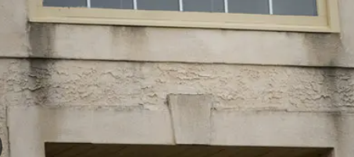
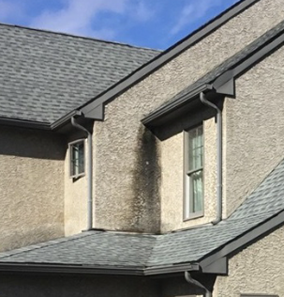
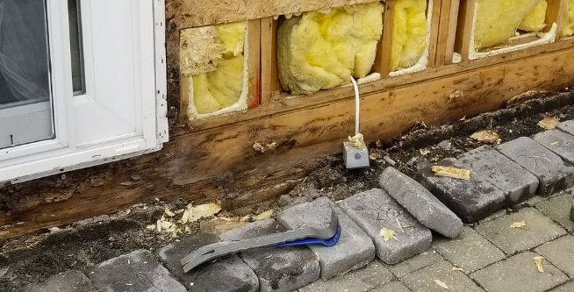
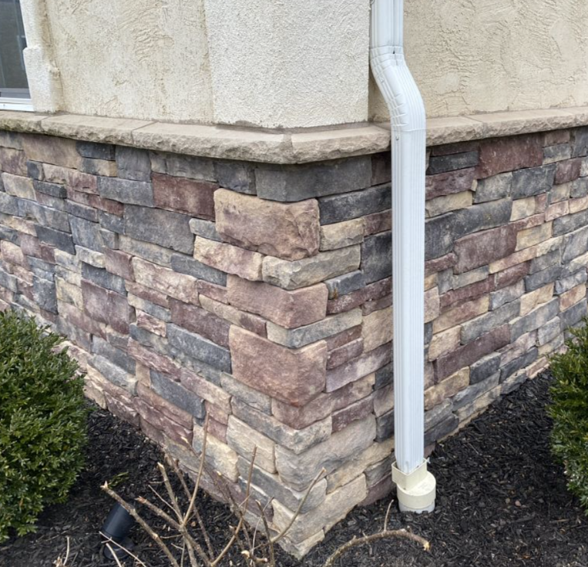
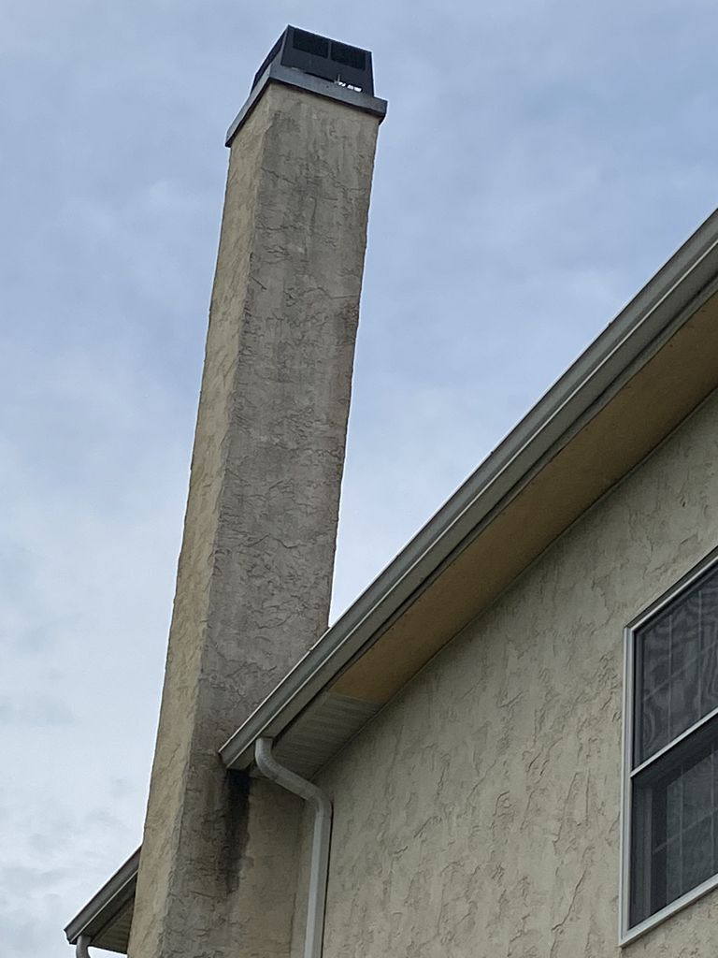
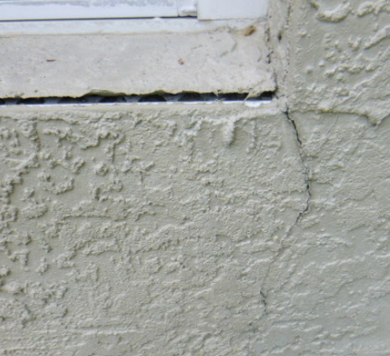
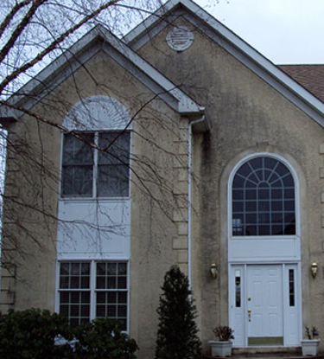
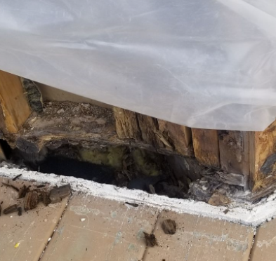
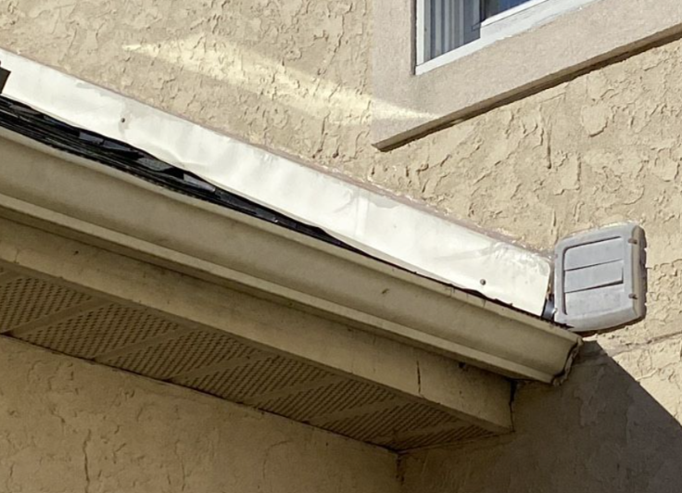
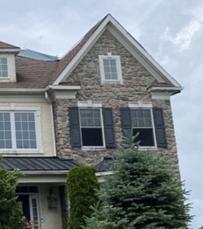
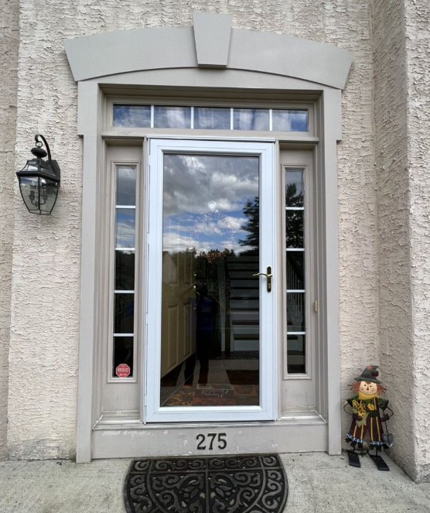
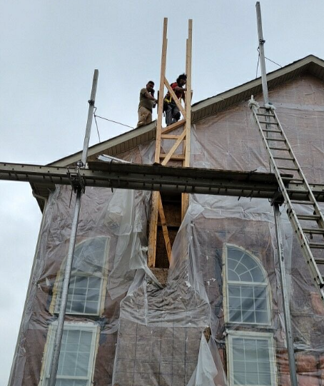
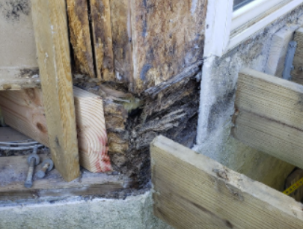
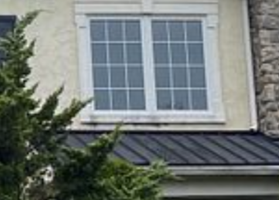
SOME INDICATIORS OF STUCCO ISSUES
WINDOWS & DOORS
ROOF LINES
DECK & PATIO
STONES
CHIMNEY

Slide 21
MHX IS A GREAT ASSET AND PARTNER TO MANY REALTORS NOW!
OUR BUSINESS PLAN IS A CONTINUOUS REINVESTMENT
IN THE TECHNOLOGY AND PEOPLE!

